Slide 1
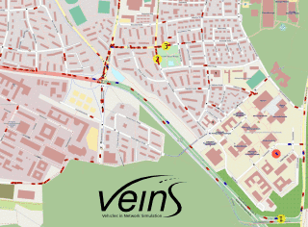
Exploration of Use Cases within VEINS
The University of Texas at Dallas:
Caleb Hoff, Tram Pham, Henry Tran, James Wei, Dylan Yu

Slide 2
Outline
Introduction and Motivation
Approach
  Use Case 1: Situational Awareness - Obstacle Collision 2.0
  Use Case 2: Loss of Sensor or Network
Issues Encountered
Situational Awareness - Obstacle Collision 2.0
Loss of Sensor

Slide 3

Introduction and Motivation
Veins is an open source framework for running vehicular network simulations. It is based on two well-established simulators: OMNeT++, an event-based network simulator, and SUMO, a road traffic simulator.
There are catastrophic consequences from cybersecurity attacks against confidentiality, integrity, and availability.
Concerned about the loss of life and simulating use cases and implementing security controls can help prevent injury and death.

Slide 4
Approach
Use Case 1: Situational Awareness - Obstacle Collision 2.0
extension of use case Situational Awareness - Obstacle (SAW - O)
classification of foreign objects and implement appropriate courses of action to avoid collision
consideration of spoofed object messages and hijacked detection systems
Use Case 2: Loss of Sensor or Network
new use case where communication with a sensor on the vehicle is lost
goal is to implement a foundation of security controls whenever a node loses connection so it can still operate safely without sensory feedback

Slide 5
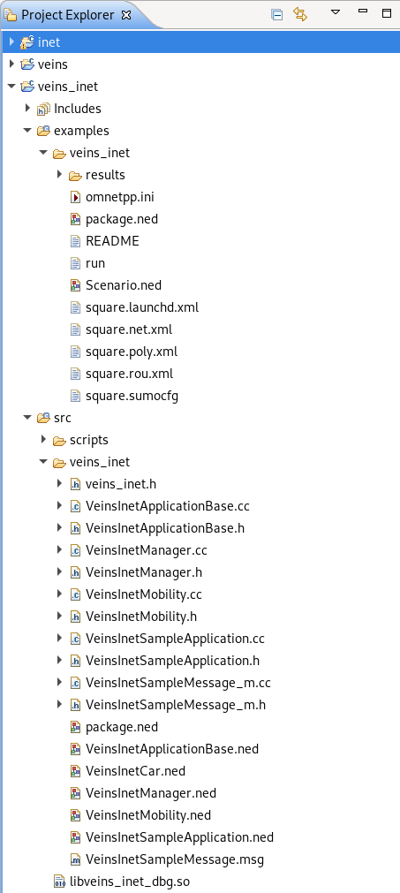
Issues Encountered
Setting up environment
Issues with documentation
Excess of scattered source code (too many subfolders with similar naming schemes)
Undocumented dependencies

Slide 6
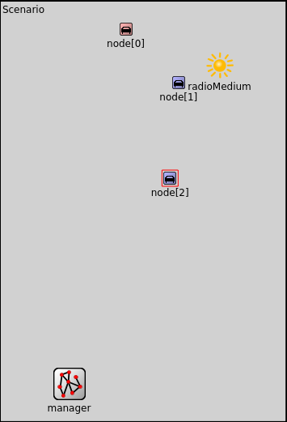
Situational Awareness - Obstacle Collision 2.0
Classification of obstacles as moving or stationary
Car (node[0]) that detects the foreign object relays a collision message to other nodes containing a RoadId
Cars (node[1]/[2]) that receive the message will be changed into a cautionary status indicated blue and be rerouted on an alternative path not on that RoadId
Progression of use case will be extended into use case 2

Slide 7
Loss of Sensor
Communication with a sensor on the vehicle is lost
Implement a foundation of security controls whenever a node loses connection so it can still operate safely without sensory feedback
Focus on a cautionary safe state for a vehicle to prevent loss of life
Voting system to filter out single malicious messages

Slide 8

Questions?

